Slide 1
Outline
Introduction to hardware description language (HDL)
Why it is better than schematic entry
Verilog語法 1 (Functional viewpoints)
Modules and ports
Basic syntax rules
Structural Verilog
How to model combinational logic
How to model sequential logic
Verilog語法 2 (Language viewpoints)
One language, many coding styles
Continuous v.s. procedural assignments
Blocking vs NonBlocking
For loop and parameterized design
SystemVerilog
Gotchas 正確的使用方法 <= (會踩到的陷阱)
Notes:
Here is a list of lecture objectives. They are provided for you to reflect on
what you are supposed to learn, rather than an introduction to this lecture.
I want, by the end of this lecture, to give you some idea about the basic
structure and syntax of Verilog. I want to convince you that schematic
capture is NOT a good way to design digital circuits. Finally, I want you to
appreciate how to use Verilog to specify a piece of hardware at different
levels of abstraction.

Slide 2
SystemVerilog design enhancement (partial)

Slide 3
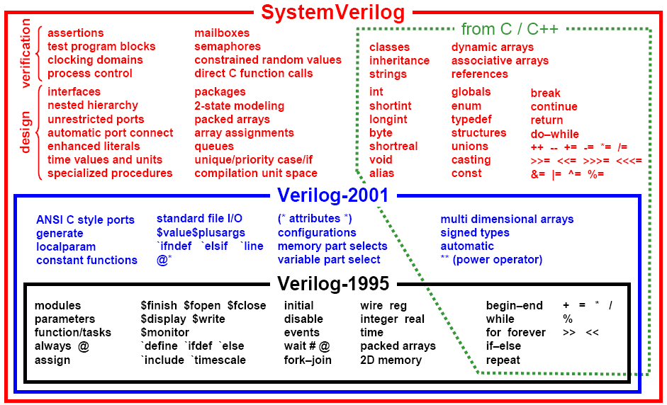
SystemVerilog is a Huge Extension of Verilog

Slide 4
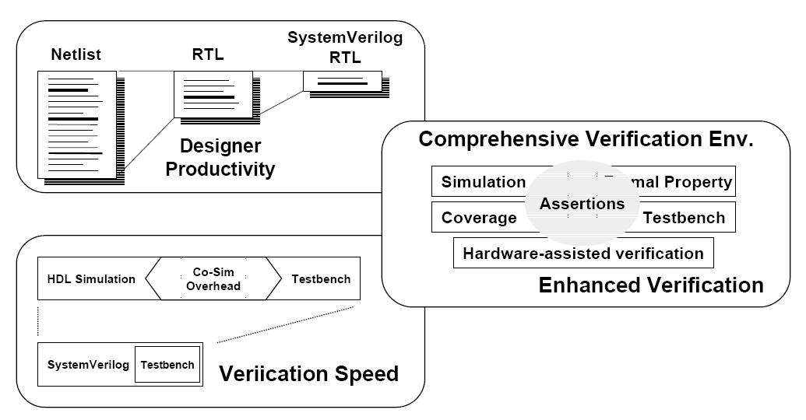
SystemVerilog Means Productivity

Slide 5
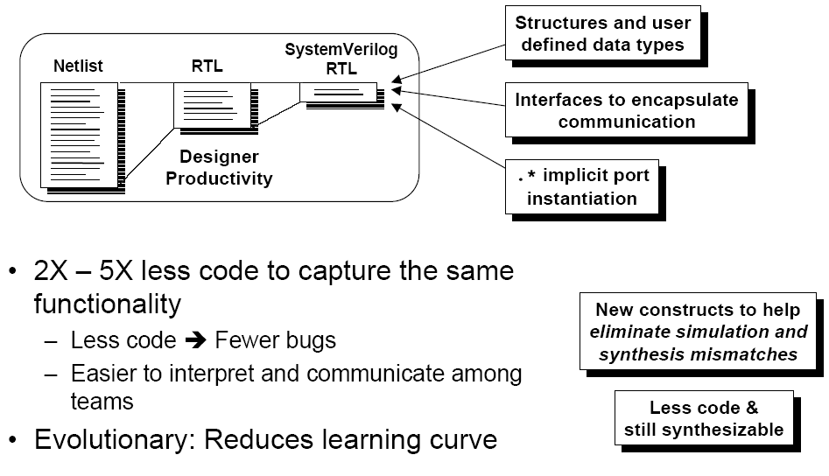
Increase Designer Productivity

Slide 6
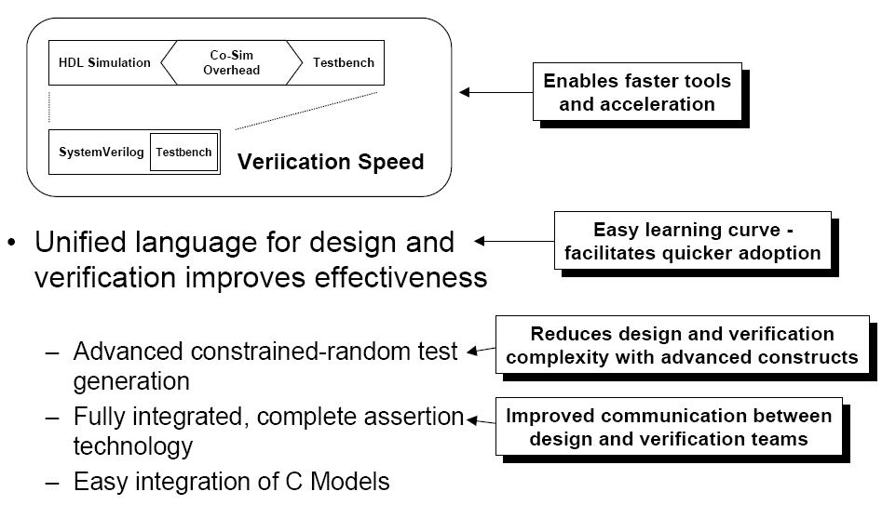
Single Language for Design and Verification: HDVL

Slide 7
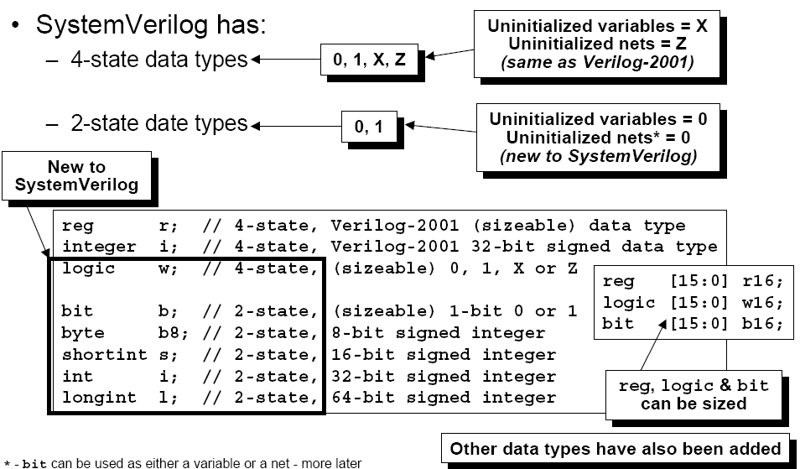
SystemVerilog Data Types

Slide 8
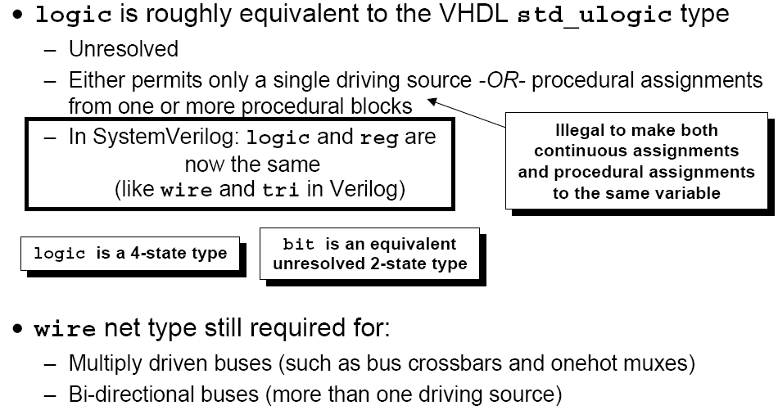
Almost Universal Data Types: logic (or reg)
Error code
assign a = b+ 1;
always_comb
a = d + 3;
Logic is a better name than reg, so is preferred
Notes:
assign a = b+ 1;
assign a = c+ 2;
always_comb
a = d + 3;

Slide 9
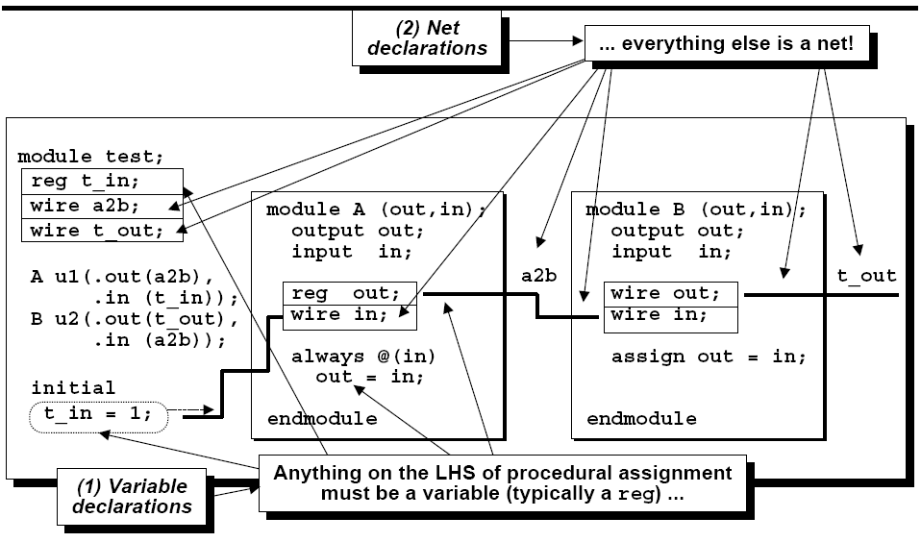
Verilog 2001 Data Types

Slide 10
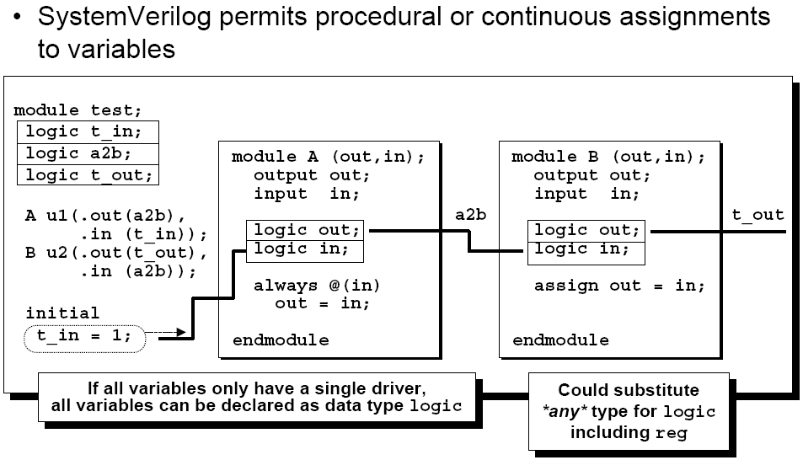
Almost Universal Data Types: logic

Slide 11
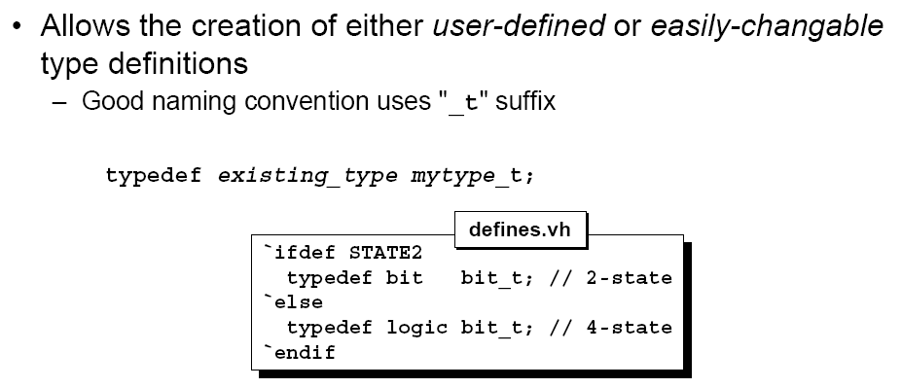
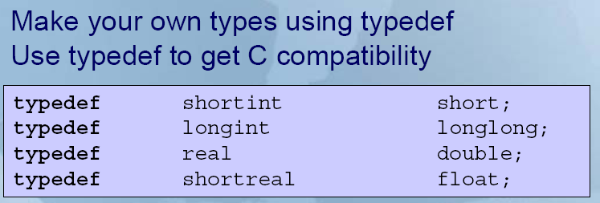
User Defined Types: typedef

Slide 12
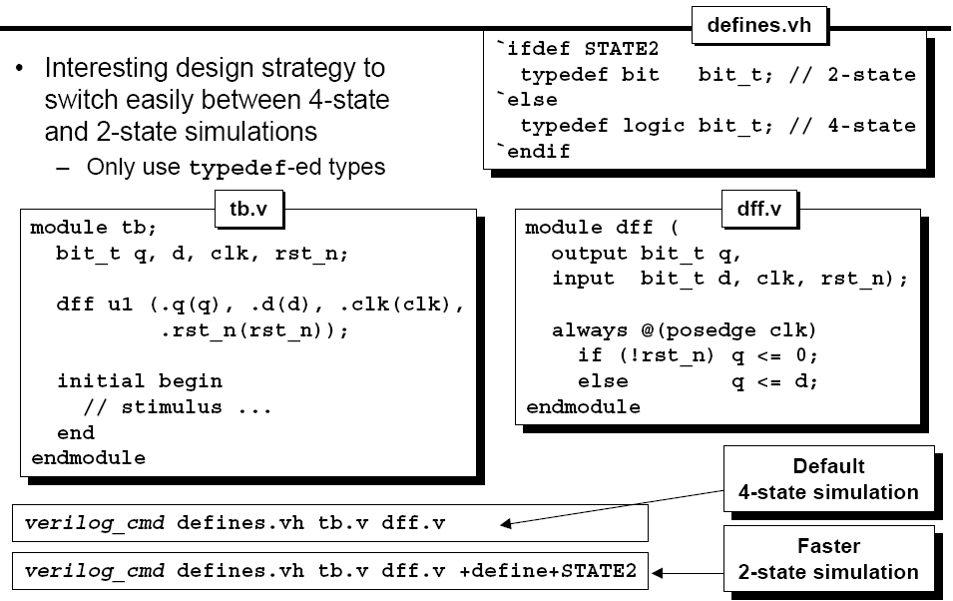
Design Strategy: Use All typedef’s

Slide 13
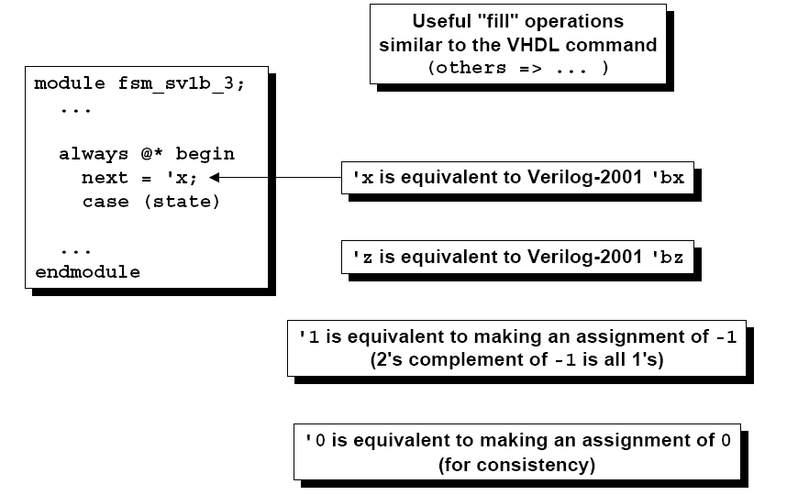
Enhanced Literal Number Syntax

Slide 14
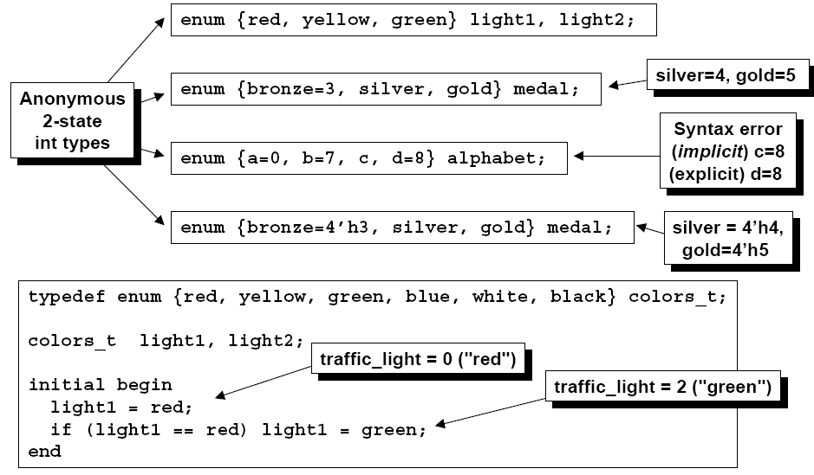
Enumerated Data Types
By default, the first get the value 0
Allow to define a datatype whose values have names
Useful for state coding, op code, or symbolic data
Notes:
列舉

Slide 15
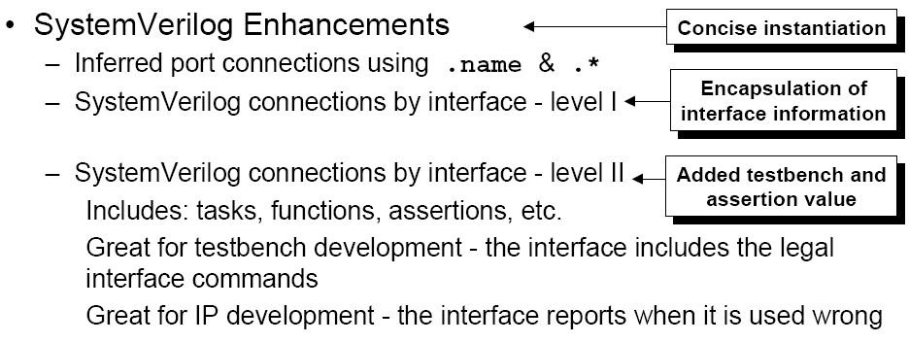
Port Instance and Port Connections

Slide 16
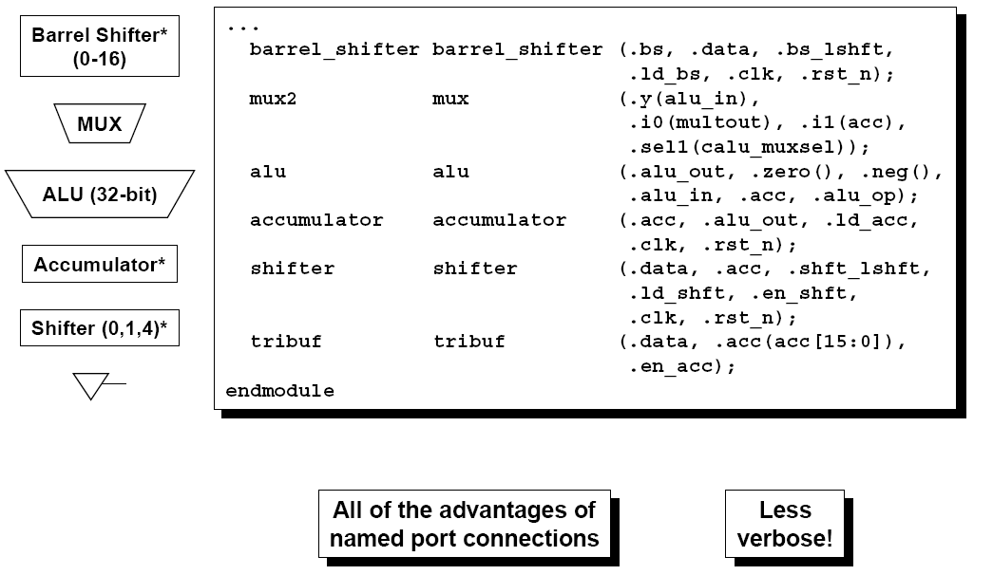
.Name Implicit Port with SystemVerilog
Use .name if port name and interconnection wire name are the same
Port 名稱與接線名稱相同
寫port名稱就可以
Notes:
Port 名稱與接線名稱相同
寫port名稱就可以

Slide 17
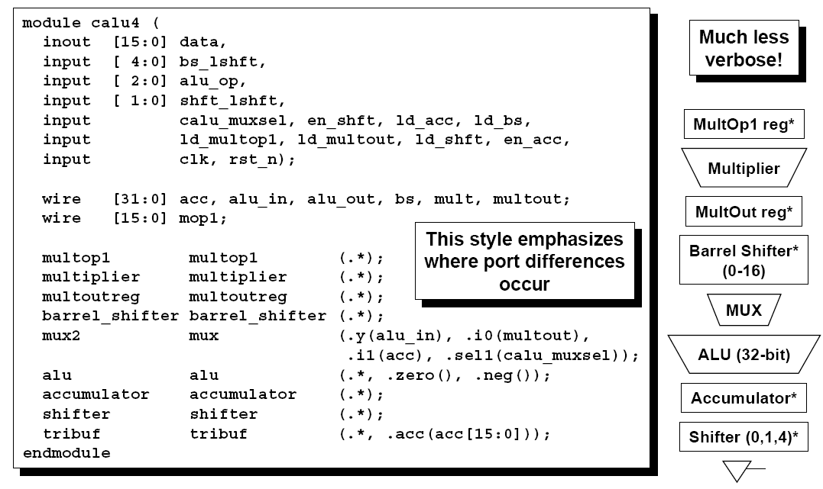
.* Implicit Port with SystemVerilog
.* only needs to specify the difference
Notes:
Port 名稱與接線名稱相同
用 .* 代替
不同的才寫

Slide 18
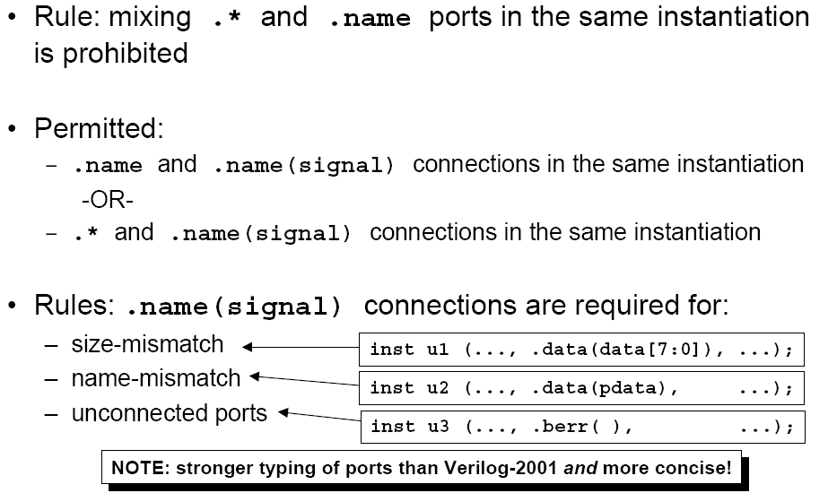
Rule for .* and .name Connections
Notes:
大小不同
名字不同
空接

Slide 19
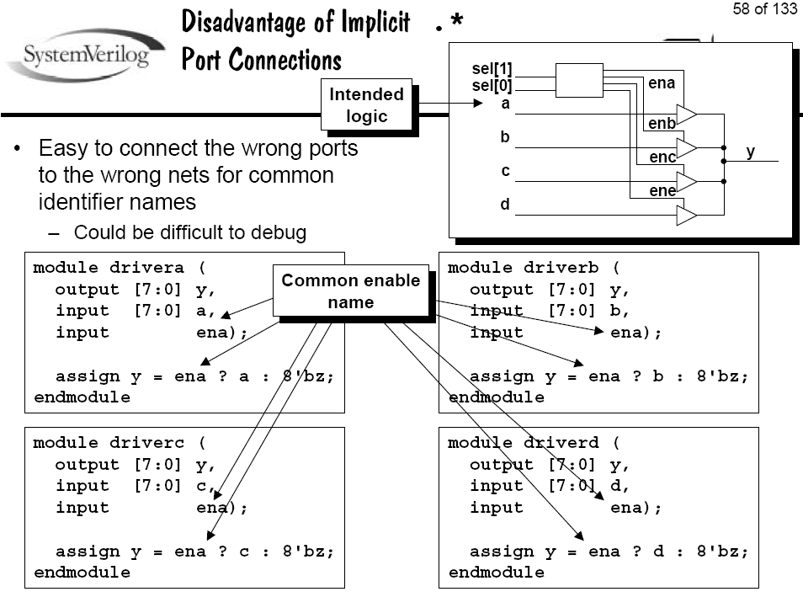

Slide 20
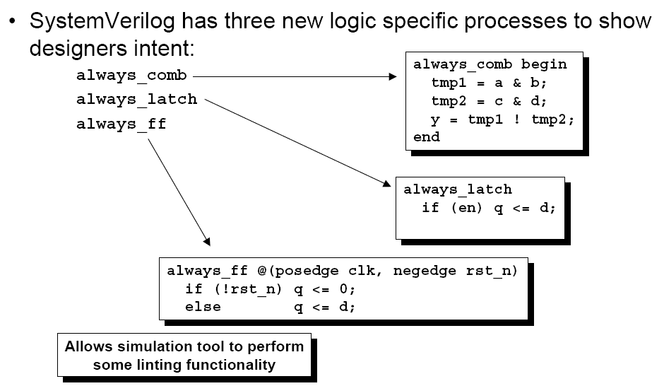
Logic-Specific Processes

Slide 21
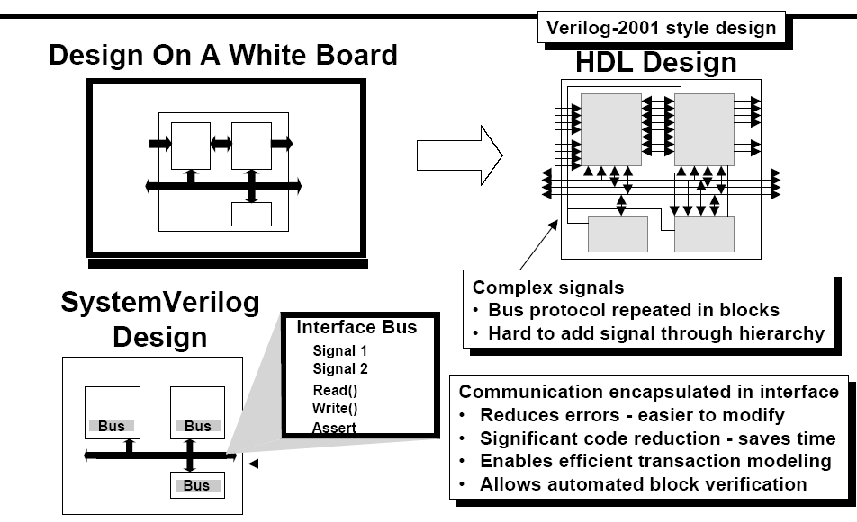
SystemVerilog Interface

Slide 22
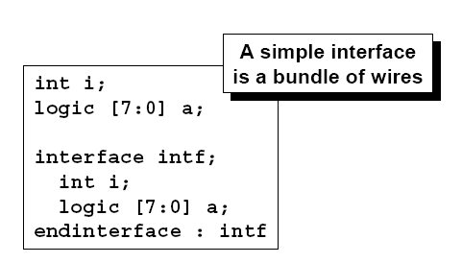
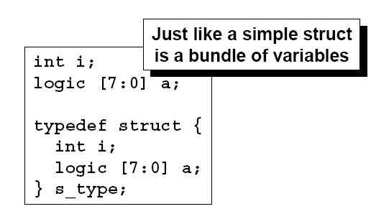
What is an Interface?
Provides a new hierarchical structure
Encapsulates interconnect and communication
Separates communication from functionality
Eliminates "wiring" errors
Enables abstraction in the RTL

Slide 23
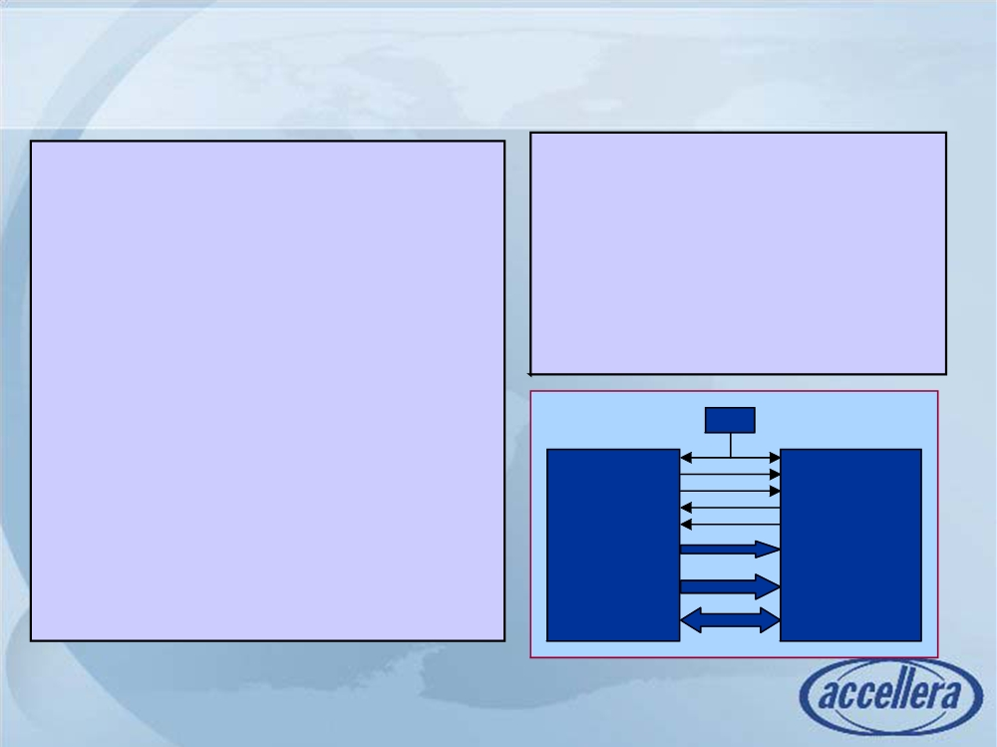
Example without Interface
module memMod(input logic req,
module top;
bit clk,
logic req,gnt,start,rdy;
logic start,
bit clk = 0;
logic [1:0] mode;
logic[1:0] mode,
logic [7:0] addr,data;
logic[7:0] addr,
inout logic[7:0] data,
memMod mem(req,clk,start,mode,
output logic gnt,
addr,data,gnt,rdy);
logic rdy);
cpuMod cpu(clk,gnt,rdy,data,
always @(posedge clk)
req,start,addr,mode);
gnt <= req & avail;
endmodule
endmodule
Top
clk
module cpuMod(input bit clk, logic gnt,
logic rdy,
req
start
inout logic [7:0] data,
gnt
output logic req,
CPU
rdy
Mem
logic start,
mode[1:0]
logic[7:0] addr,
addr[7:0]
logic[1:0] mode);
data[7:0]
endmodule

Slide 24
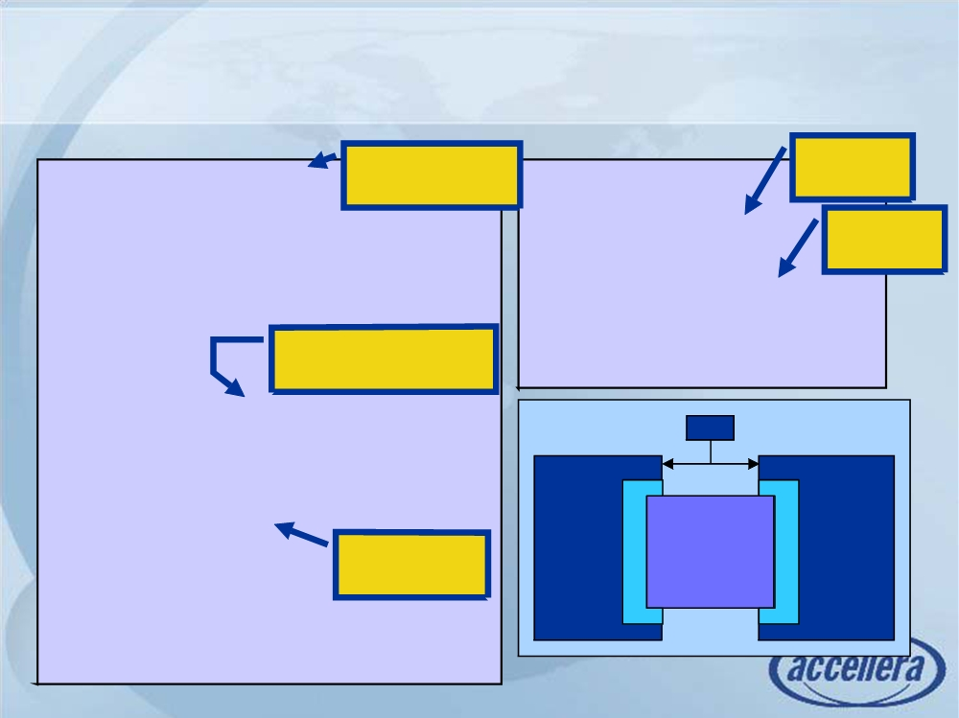
Example Using Interfaces
Bundle signals
interface
interface simple_bus;
in interface
module top;
instance
logic req,gnt;
bit clk = 0;
logic [7:0] addr,data;
simple_bus sb_intf;
Connect
logic [1:0] mode;
interface
logic start,rdy;
memMod mem(sb_intf, clk);
endinterface: simple_bus
cpuMod cpu(.b(sb_intf),
Use interface
.clk(clk));
keyword in port list
endmodule
module memMod(interface a,
Top
input bit clk);
clk
logic avail;
always @(posedge clk)
a.gnt <= a.req & avail;
sb_intf
endmodule
CPU
Mem
Refer to intf
signals
module cpuMod(interface b, input bit clk);
endmodule

Slide 25
Outline
Introduction to hardware description language (HDL)
Why it is better than schematic entry
Verilog語法 1 (Functional viewpoints)
Modules and ports
Basic syntax rules
Structural Verilog
How to model combinational logic
How to model sequential logic
Verilog語法 2 (Language viewpoints)
One language, many coding styles
Continuous v.s. procedural assignments
Blocking vs NonBlocking
For loop and parameterized design
SystemVerilog
Gotchas 正確的使用方法 <= (會踩到的陷阱)
Notes:
Here is a list of lecture objectives. They are provided for you to reflect on
what you are supposed to learn, rather than an introduction to this lecture.
I want, by the end of this lecture, to give you some idea about the basic
structure and syntax of Verilog. I want to convince you that schematic
capture is NOT a good way to design digital circuits. Finally, I want you to
appreciate how to use Verilog to specify a piece of hardware at different
levels of abstraction.

Slide 26
Gotchas
Verilog 正確的使用方法 <= (會踩到的陷阱)
Notes:
容易踩到的陷阱

Slide 27
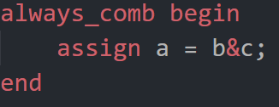
Combinational Logic
initial value for combinational logic will be ignored for synthesis
No assign block (legal but not synthesizable)
WRONG!!!
硬體設計沒有起始值這種東西
logic a =0;
assign a=b+c;

Slide 28

How to Properly Initialize a DFF?
Reset DFF registers
You can reset DFF when rst_n triggers
Do not use initial begin since it is not synthesizable
always_ff@(posedge clk or negedge rst_n)
if(rst_n == 0)
a <= 0;
else
a <= b;
initial a = 0;
logic a = 0;
Bad for design, not synthesizable
Only for testbench simulation
Initial values are ignored for synthesis

Slide 29
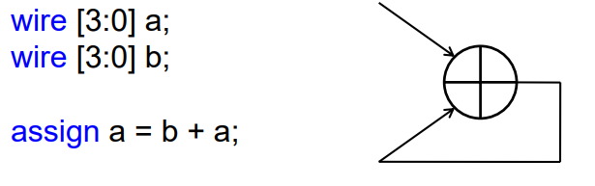

Combinational Loop
A variable cannot be assigned by itself in combinational logic
Combinational loop (timing loop)
always_comb
a = b+a;
always_ff@(posedge clk)
a <= b+a;
Same variable in both sides
only allowed in seq. logic
Same variable in both sides
WRONG!!! Not synthesizable

Slide 30
Multiple Drivers
Multiple driver
One variable can only be assigned in one always block or in one assign
This will cause race conditions (actual values depends simulator scheduling)
Solution: multiple source statements should put in the same always or assign
always_comb
a = e+f;
always_comb
a = 2;
assign a=c+d;
assign a=4;
always_comb bein
a = e+f;
a = 2;
end
Initial //at t=0
a = 1;
Initial //at t=0
a = 0;
logic a = 1;
Same for initial statement
and always_ff

Slide 31
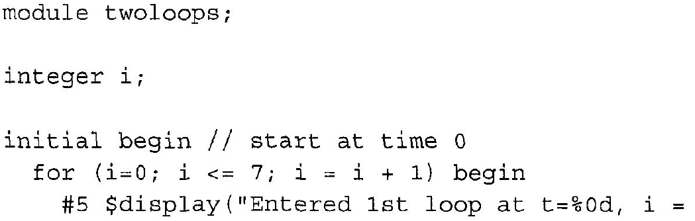
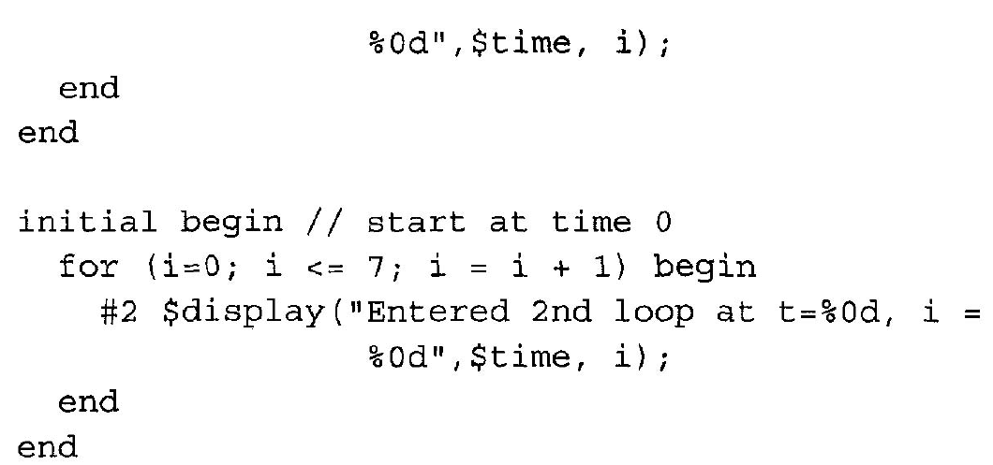
Same variable used in two loops running simultaneously
Index variable i in both loops will conflict

Slide 32
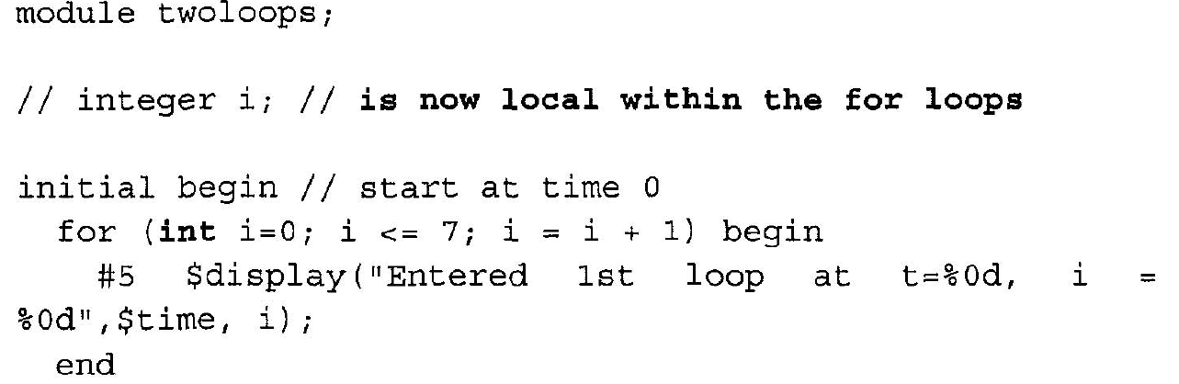
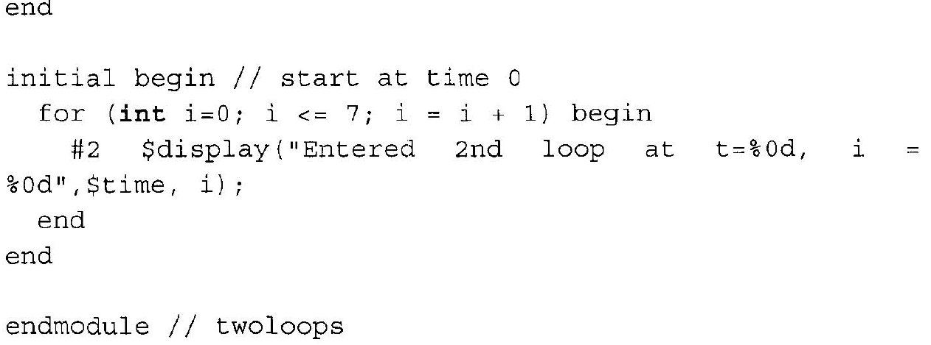
Use local variable within for loop

Slide 33
Sizing in Verilog
Verilog automatically resizes values in an expression according to the sizes of variables in the expression.
Verilog automatically truncates or extends the right-hand-side value in an assignment to fit the left-hand-side variable.
module sign_size;
reg [3:0] a, b;
reg [15:0] c;
initial
begin
a = -1; // a is unsigned, so it stores “1111”
b = 8;
c = 8; // b = c = 1000
#10 b = b + a; // result 10111 is truncated. b = 0111
#10 c = c + a; // c = 0000000000010111
end
endmodule

Slide 34
Sizing in Verilog
Self-determined versus context-determined operators
context-determined operator
looks at the size and data types of the complete statement before performing its operation. All operands in the statement are expanded to the largest vector size of any operand before the operations are performed
logic [5:0] a = 6'b010101; II 6-bit vector
logic [3:0] b = 4'b1111; II 4-bit vector
logic [7:0] c; II 8'bit vector
c = a & b; II results in 8-bit 00000101
Notes:
Gotcha 44
In this example, the context of the bitwise AND operation includes the vector
sizes of a, band c. The largest vector size is 8 bits. Therefore, before doing the
operation, the 4-bit vectorandthe 6-bitvector are expanded to 8-bitvectors.
Why were a andb left extended with zeros? Thisquestion is answered in Gotcha
46 on page 105, which discusses zero-extension andsign-extension in Verilog,

Slide 35
A self-determined operator
is only affected by the data types of its operands. The operation is not affected by the context in which it is performed. For example, a unary AND operation will AND all the bits of its operand together, without changing the size of the operand.
logic [5:0] a = 6'b101010; // 6-bit vector
logic [3:0] b = 4'b1111; // 4-bit vector
logic [7:0] c; //8'bit vector
c = a I (&b); // results in 8-bit 00101011
Notes:
In this example, the unaryANDof o ( &b) is self-determined. Thevector sizesof
a and c haveno bearing on the unaryAND of'b, Theresultof ANDing the bits of
4 ' b 1111 together is a 1 ' b 1.
If the self-determined operator is part of a compound expression, as in the
example above, then the result of the self-determined operator becomes part of
the context for the rest of the statement.
What if &bhadbeencontext-determined? In context, b would firstbe expanded to
8 bits wide, becoming 00001111. TheunaryAND of this value is 1 ' b 0, instead
of l' b1. The result of a I &b would be 00101010, which would be the wrong
answer. But this is not a gotcha, because the unary AND operator is selfdetermined,
and therefore gets the correct answer.

Slide 36
Imcompleted case / if-else => unintentional latch
module mux4( input a, b, c, d
input [1:0] sel,
output out );
reg out;
always @( * )
begin
if ( sel == 2’d0 )
out = a;
else if ( sel == 2’d1 )
out = b
else if ( sel == 2’d2 )
out = c
else if ( sel == 2’d3 )
out = d
//else
// out = 1’bx;
end
endmodule
module mux4( input a, b, c, d
input [1:0] sel,
output out );
reg out;
always @( * )
begin
case ( sel )
2’d0 : out = a;
2’d1 : out = b;
2’d2 : out = c;
2’d3 : out = d;
//default : out = 1’bx;
endcase
end
endmodule
case
Nested if-else
6.375 Complex Digital Systems

Slide 37
How to Find Incomplete Case/if-else
Code review
By tools
Linting tools: nLint (renamed as Synopsys Spyglass Lint)
Synthesis tools: check “latch” keyword in the synthesis log
Compiler generates warning messages when inferring latches

Slide 38
SpyGlass(renamed from nLint) rule(1)
Simulation
Combinational Loop
Infinite Loop
Signal in Sensitivity List Changed in the Block
Loss of Significant Bit
Synthesis
Logic Expression Used in Sensitivity
Delay in Non-blocking Assignment
Blocking/Non-blocking Assignment in Edge-triggered Block
Inferred Latch
ERC
Floating Net
Partial Input Floating
Output Floating
Input Floating
DFT
Gated Clock
Buffered Clock
Reset Driven by Combinational Logic

Slide 39
nLint rule(2)
Design Style
Two-process Style Not Used for FSM
Clock Driven by Sequential Logic
Clock Signal Used on Both Edges
No Set or Reset Signal
No Glue Logic Allowed in Top Module
Language Construct
Bit Width Mismatch in Assignment
Multi-bit Expression when One Bit Expression is Expected
Bit Range Specified for Parameter
Bit Width Mismatch Between Module Port and Instance Port
HDL Translation
Verilog/VHDL Reserved Words
Include Compiler Directive Used
Naming Convention
Port Name Too Long
Clock Name Prefix or Suffix
Active Low Signal Name Prefix or Suffix
Port Name Does Not Follow the Connected Signal

Slide 40
nLint rule(3)
Coding Style
Line Too Long
TAB Used in Indentation
More than One Statement per Line
Unconventional Port Declaration Order
VITAL Compliant
For VHDL only
Clock
Generated Reset
Generated Clock
Tri-state Buffer in a Clock Path
Block Interconnect
Conflict of Hierarchy Interconnection
Block Assembly Error in the Same Hierarchy Level

Slide 41
Blocking vs. non-blocking assignment
Blocking assignment (for combinational circuit)
The assignment will be carried consequently.
Non-blocking assignment (for sequential circuit)
The assignment will be carried in parallel.
Blocking
Non-blocking
always@( posedge clk )
begin
b = a;
c = b;
end
always@( posedge clk )
begin
b <= a;
c <= b;
end
T=0
a=2,
b=1
Notes:
假設在a=2 的clock

Slide 42
Blocking vs. non-blocking assignment
Blocking
always@( posedge clk )
begin
b = a;
c = b;
end
reg
a
c
Non-blocking
always@( posedge clk )
begin
b <= a;
c <= b;
end
reg
reg
a
b
c

Slide 43
Value Swap
initial begin
x = 5;
y = 3;
end
always @(negedge clock) begin
x = y;
y = x;
end
always @(negedge clock) begin
x <= y;
y <= x;
end
This will give both x and y the same value.
Race condition: If the circuit was to be built a race condition has been entered which is unstable. The compliler will give a stable output, however this is not the output expected.
The simulator assigns x the value of 3 and then y is then assigned x. As x is now 3, y will not change its value.
both the values of x and y are stored first. Then x is assigned the old value of y (3) and y is then assigned the old value of x (5)
Notes:
http://xilinx.pe.kr/_hdl/2/RESOURCES/www.ee.ed.ac.uk/~gerard/Teach/Verilog/me5cds/me95jpbh.html

Slide 44
(Don’t) Mix Blocking and NonBlocking
always @ (posedge clk) begin
if(shiftIndex == 0) begin
if(dataValid == 1) transmitting = 1; //Blocking assign
else transmitting = 0; //Blocking assign
end
if(transmitting == 1) begin
shiftIndex <= shiftIndex + 1;
dataOut <= data5b[shiftIndex];
if(shiftIndex == 4) begin
complete <= 1;
shiftIndex <= 0;
end
else begin
complete <= 0;
end
end
end
always @* begin
if(shiftIndex == 0) begin
if(dataValid == 1) transmitting = 1; //Blocking assign
else transmitting = 0; //Blocking assign
end
end
always @ (posedge clk) begin
if(transmitting == 1) begin
shiftIndex <= shiftIndex + 1;
dataOut <= data5b[shiftIndex];
if(shiftIndex == 4) begin
complete <= 1;
shiftIndex <= 0;
end
else begin
complete <= 0;
end
end
end
//only evaluated on positive clock edge
Notes:
When using the blocking (=) assignment the value is available to use in the next line of code. This implies it is combinatorial and not driven from a flip-flop.
In simulation it looks like it is driven from a flip-flop because the block is only evaluated on positive clock edge, in reality it is not which might break the interface.
I am of the faction which says never mix styles, as it can be a problem in code reviews and refactoring. The refactor, if a module needs to output a new signal and it is seen that it already exists they just change to be an output. At first glance looked like it was a flip-flop because it was in a always @(posedge clk block.
Therefore I would recommend to NOT mix styles, but pull out the section that is combinatorial and put it in its own block. Does this still meet your requirements? if not then you would have had problem.
I do not see how data valid is controlled but it can change the output transmitting, potentially transmitting could also glitch as it is from a combinatorial decode, not driven cleanly from a flip-flop. The receiving interface might be async, glitches could cause lock up etc.
https://stackoverflow.com/questions/28599018/mixing-blocking-and-non-blocking-assign-in-verilog-or-not

Slide 45
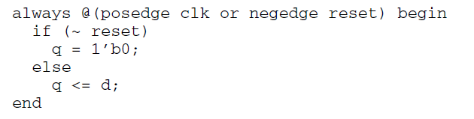
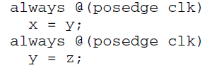
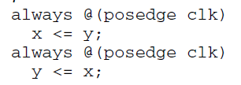
Race Condition Using Blocking Assignments
Notes:
Presto Verilog does not permit this and generates an error message.

Slide 46
Tri-State Logic
If possible, use multiplexors to replace tri-state logic
Used for bidirectional I/O pad
How to write tri-state logic?
// module declaration
module tri_state_buffer( data_in, data_out, data_pad, ctrl);
// port declaration
input [15:0] data_in;
input ctrl;
output [15:0] data_out;
inout 15:0] data_pad;//bidirectional port
// structure
assign data_pad = (ctrl)? data_in : 16’hz;
assign data_out = data_pad;
endmodule

Slide 47
Tri-State Logic
Use in on-chip bus or I/O pad

Slide 48
Verilog Modeling Style for Synthesis

Slide 49
Quick Glimpse of Synthesizable Subset
Not all of the Verilog commands can be synthesized into hardware
always | begin end | case endcase | casez endcase
if else | module endmodule | input output | function
reg Wire logic | default | posedge negedge | parameter
or | assign | for

Slide 50
What is Synthesis ?
Synthesis = translation + optimization + Mapping
Phase I
Phase II

Slide 51
Synthesizable Built-in Primitives
Multi-input Gates | Multi-output Gates | Tri-state Gates | Pull Gates | Unidirectional Switches | Bidirectional Switches
and nand or nor xor xnor | buf not | bufif0 bufif1 notif0 notif1 | pulldown pullup | cmos nmos pmos rcmos rnmos rpmos | rtran rtrainif0 rtranif1 tran tranif0 tranif1
Synthesizable !!
Non-Synthesizable !!

Slide 52
Synthesizable Operator Types
Type of Operators | Symbols
Concatenate & replicate | { } {{ }}
Unary | ! ~ & | ^
Arithmetic | * / % + - **
Logical shift | << >> <<< >>>
Relational | > < >= <=
Equality | == === != !==
Binary bit-wise | & | ^ ~^
Binary logical | && ||
conditional | ? :
DC allows “**” operator performs y^{x} synthesis, but exponentiation is only supported if the base is a power of 2 (ex: 2^{x}, 4^{x}, 8^{x}, …) or the exponent is 2 (ex: y²)

Slide 53
Combinational Logic
initial value for combinational logic will be ignored for synthesis
No assign block (legal but not synthesizable)
WRONG!!!
Wrong
logic a =0;
assign a=b+c;

Slide 54
How to Properly Initialize a DFF?
Reset DFF registers
You can reset DFF when rst_n triggers
Do not use initial begin since it is not synthesizable
always_ff@(posedge clk or negedge rst_n)
if(rst_n == 0)
a <= 0;
else
a <= b;
initial a = 0;
logic a = 0;
Bad for design, not synthesizable
Only for testbench simulation
Initial values are ignored for synthesis

Slide 55
Combinational Loop
A variable cannot be assigned by itself in combinational logic
Combinational loop (timing loop)
always_comb
a = b+a;
always_ff@(posedge clk)
a <= b+a;
Same variable in both sides
only allowed in seq. logic
Same variable in both sides
WRONG!!! Not synthesizable

Slide 56
Resource Sharing: Area Reduction Technique
HDL coding style can force a specific topology to be synthesized
SUM1 = A+B+C; SUM2 = A+B+D; SUM3 = A+B+E;
assign tmp = A+B; SUM1 = tmp +C; SUM2 = tmp +D; SUM3 = tmp +E;
A B C
A
B
D A
B
E
A
B C
D
E
Sharing
SUM1
SUM2
SUM3
SUM1
SUM2
SUM3

Slide 57
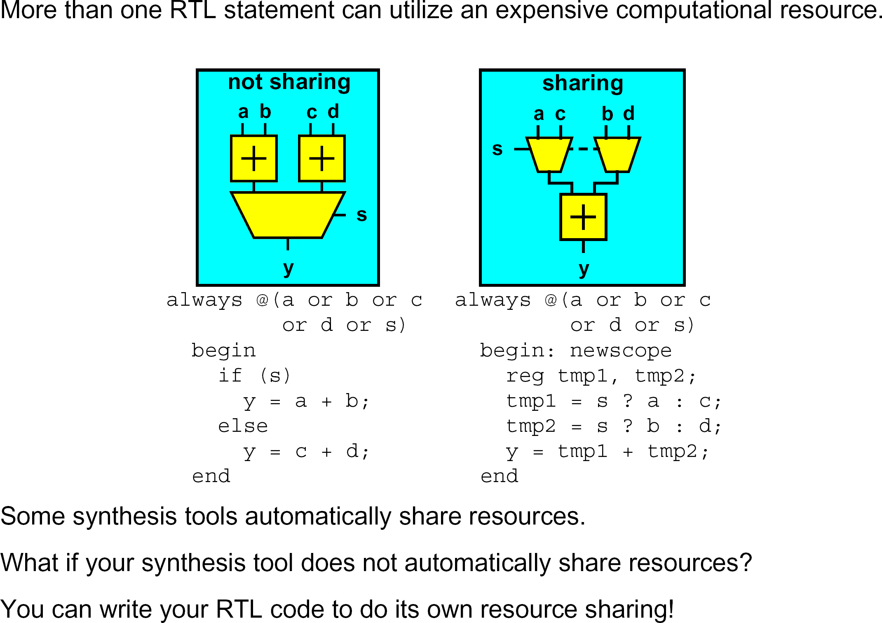
Architectural Techniques : Resource Sharing

Slide 58
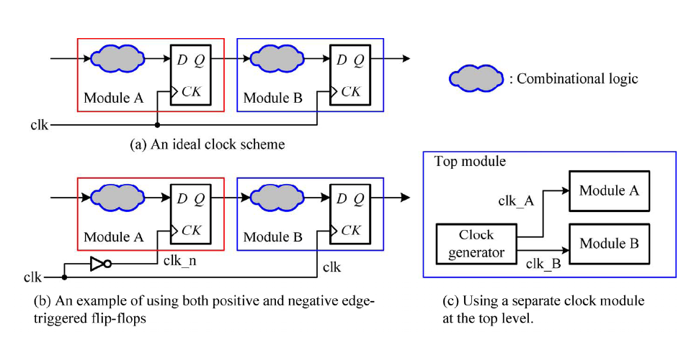
Coding Guidelines for Clocks (1/3)
Using single global clock (Fig. (a))
Avoiding mixed use of both positive and negative edge-triggered flip-flops (Fig. (b))
Avoiding using internally generated clock signals (Fig. (c))
Avoiding using gated clocks (in next slides)
Digital System Designs and Practices Using Verilog HDL and FPGAs John Wiley

Slide 59
Coding Guidelines for Clocks (2/3)
Clock Gating
For low power design
50% - 70% power consumed in clock network report
Doing the clock gating by using power synthesis tools
assign clk1 = clk &en;
always @ (posedge clk1)
Q <= Q_nxt
always @ (posedge clk)
if(en)
Q <= Q_nxt

Slide 60
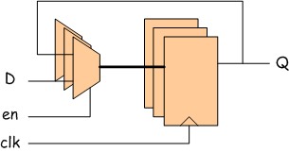
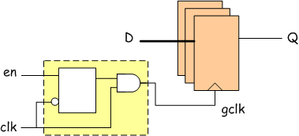
Coding Guidelines for Clocks (3/3)
always@(posedge clk)
if (en) Q <= D;
always@(posedge clk)
Q <= (en)? D : Q;
high activity !!
always@(posedge clk)
case (en)
1’b1 : Q <= D;
1’b0 : Q <= Q;
endcase
By Power compiler
always@(posedge clk)
if (en) begin
for (i=0; i<8; i=i+1)
s[ i ] = a[ i ] & b[ i ];
end
CG cell
low activity !!

Slide 61
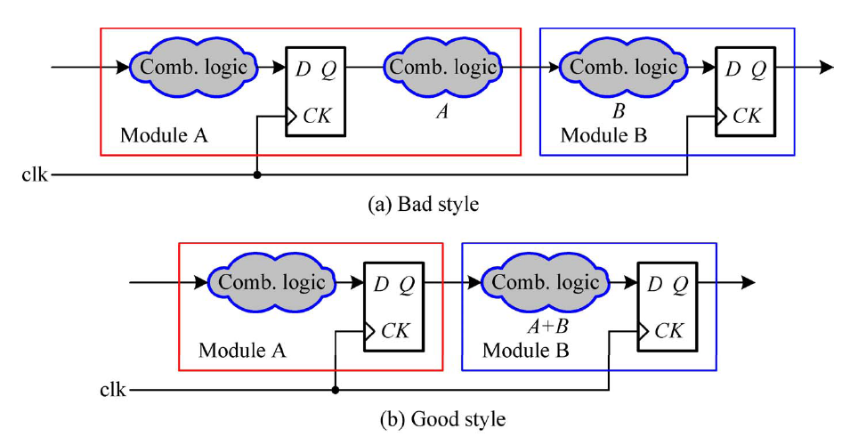
Partitioning for Synthesis (1/2)
Keep related logic within the same module
Register all outputs
Digital System Designs and Practices Using Verilog HDL and FPGAs John Wiley

Slide 62
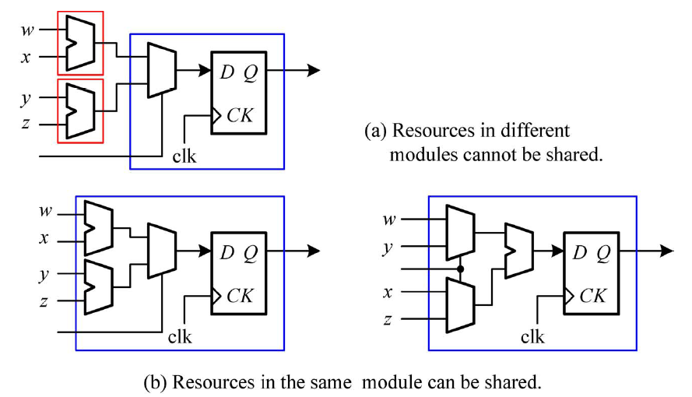
Partitioning for Synthesis (2/2)
Maintaining the original hierarchy
Digital System Designs and Practices Using Verilog HDL and FPGAs John Wiley

Slide 63
Logic Grouping
A = B + C + D + F;
B
C
D
F
+
+
+
A
A = (B + C) + (D + F);
B
C
D
F
+
+
+
A

Slide 64
Priority Encoder if-else (?:) v.s. case
module mux (in0, in1, in2, in3, sel, mux_out);
input in0, in1, in2, in3;
input [1:0] sel;
output mux_out;
reg mux_out;
always @(in0 or in1 or in2 or in3 or sel) begin
case (sel)
2'b00: mux_out = in0;
2'b01: mux_out = in1;
2'b10: mux_out = in2;
default:mux_out = in3;
endcase
end
endmodule
in0
case will have faster ckt
in1
mux_out
in2
in3
sel
Generally, If-Else is slower unless you intend to build a priority encoder!
module p_encoder (in0, in1, in2, in3, sel, p_encoder_out);
input in0, in1, in2, in3;
input [1:0] sel;
output p_encoder_out;
reg p_encoder_out;
always @(in0 or in1 or in2 or in3 or sel) begin
if (sel == 2'b00)
p_encoder_out = in0;
else if (sel == 2'b01)
p_encoder_out = in1;
else if (sel == 2'b10)
p_encoder_out = in2;
else p_encoder_out = in3;
end
endmodule
in3
in2
in1
in0
p_encoder_out
sel=10
sel=01
sel=00

Slide 65
Priority Encoder “if-then-else” When to use?
always_comb
begin
if (sel == 3'h0)
out = in[0];
else if (sel == 3'h1)
out = in[1];
else if (sel == 3'h2)
out = in[2];
else if (sel == 3'h3)
out = in[3];
else if (sel == 3'h4)
out = in[4];
else
out = in[5];
end
in [4]
in [3]
in [2]
in [1]
S
in [0]
S
S
S
Put the slowest input close to the output
Assign highest priority to a late arriving critical signal
Nested “if-then-else” can increase area and delay
Use “case” statement if possible to describe the same function

Slide 66
Inefficient vs. Efficient Description
module count ( clock, reset, and_bits, or_bits, xor_bits);
input clock, reset;
output and_bits, or_bits, xor_bits;
reg and_bits, or_bits, xor_bits;
reg [2:0] count;
always @ (posedge clock) begin
if (reset)
count = 0;
else
begin
count = count + 1;
and_bits = &count;
or_bits = |count;
xor_bits = ^count;
end
end
endmodule
Six inferred registers
Separate combinational and sequential circuits
always @ (posedge clock)
begin
if (reset)
count = 0;
else
count = count + 1;
end
always @ (count)
begin // combinational circuits
and_bits = &count;
or_bits = |count;
xor_bits = ^count;
end
Three registers are inferred

Slide 67
References
Verilog HDL – Samir Palnitkar
The Fundamentals of Efficient Synthesizable Finite State Machine Design using NC-Verilog and Build Gates – Clifford E. Cummings
Verilog: Frequently Asked Questions: Language, Applications and Extensions - Shivakumar S. Chonnad, Needamangalam B. Balachander

Slide 68
References for SystemVerilog
Books
SystemVerilog for Verification: A Guide to Learning the Testbench Language Features by Chris Spear (Hardcover - Jul 10, 2006)
SystemVerilog for Design: A Guide to Using SystemVerilog for Hardware Design and Modeling by Stuart Sutherland, Simon Davidmann, Peter Flake, and P. Moorby (Hardcover - Jul 20, 2006)
Web site
Official site: www.systemverilog.org
On-line tutorial: http://www.doulos.com/knowhow/sysverilog/
Course
MIT 6.375 Complex Digital Systems

Slide 69
Reference
https://hom-wang.gitbooks.io/verilog-hdl/content/
http://www.asic-world.com/verilog/index.html
https://www.slideshare.net/itembedded/verilog-14596615
http://www.sunburst-design.com/papers/CummingsSNUG1999SJ_SynthMismatch.pdf
http://www-inst.eecs.berkeley.edu/~cs150/fa13/agenda/
http://www.ee.ic.ac.uk/pcheung/teaching/ee2_digital/
Notes:
http://referencedesigner.com/tutorials/verilog/verilog_01.php

Slide 70
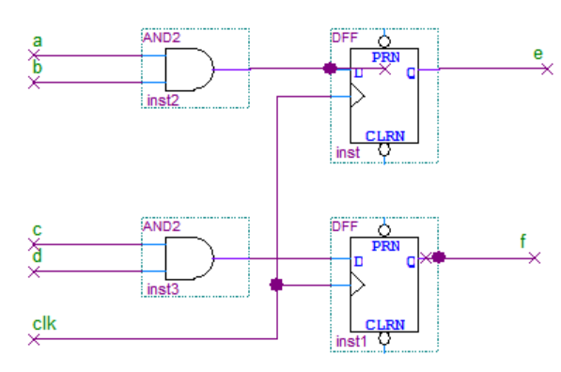
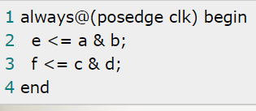
Note.由C語言學習Verilog的思維轉換
軟體是循序的，而硬體是並行的
硬體要循序，要靠clock和FSM
靠clock並且搭配FSM，當一個state完成後，進入下一個state，這樣就能依照clock的進行，而達成循序的要求
Verilog程式碼沒有先後之分
blocking assignment有先後執行順序，而nonblocking assignment同時執行
硬體『描述』語言，而非硬體『程式』語言
先寫的不代表先執行，後寫的也不代表後執行，只是代表硬體的架構的描述，也就是說，將原來的電路圖，變成文字描述而已
Notes:
https://www.cnblogs.com/oomusou/archive/2008/06/17/c_verilog_mental_thinking.html

Slide 71
Verilog vs C
Verilog 有些語法像C ，但不是軟體語言
No pointer, no return function, no recursive calls, no memory allocation
Verilog ⬄ Hardware module
了解每一行Verilog code 會產生的硬體架構
知道想做的硬體架構應該對應的Verilog code 寫法 (Coding style)
何時可以用很像C的高階寫法
在 testbench 時使用

Slide 72

幫幫EDA tools: Helping the Tools* 為什麼要建議某種寫法?
In an ideal world it shouldn’t matter how you write the Verilog – optimization in the CAD tools will find the best solution. But the world is not ideal (yet…)
Tools work best on smaller problems
Need to partition real problem into pieces for you and the tools (it’s hard to think about 1M gates at one time). Decompose large problems into smaller problems and then connect the solutions
Hierarchy in Verilog " partitions in physical layout
Tools use your code as a starting point.
Your structure isn’t completed eliminated (this is good…)
Little optimization will be done between top-level blocks
Structure of the problem is often important
Finding a “good” way to think about the problem is key
Like optimizing compilers for C, tools are good for local optimizations but don’t expect them to rewrite your code and change your algorithm. With practice you’ll learn what works and what doesn’t…
請用不讓Tool誤解的寫法
*adapted from a Stanford EE271 lecture by Mark Horowitz
Notes:
Architecture to Verilog An Extended Example

Slide 73
Simulation and Synthesis
Not all of the Verilog commands can be synthesized into hardware
Our primary interest is to build hardware, we will emphasize a synthesizable subset of the language
Will divide HDL code into synthesizable modules and a test bench (simulation).
The synthesizable modules describe the hardware.
The test bench checks whether the output results are correct (only for simulation and cannot be synthesized)
testbench.v
pattern.v
design.v
(synthesizable)

Slide 74
From Spec to Verilog RTL: TIPS for HW
Read the spec
Create some patterns to make sure you understand spec
Try some boundary cases
Draw the dataflow
Create your block diagram (architecture)
Try the naïve method first
Any possible optimization?
You can skip simple logic minimization. EDA tools will do that for you.
Possible properties to use: constant/repeat behaviour/decomposition
Based on architecture, find the related Verilog code

